Slide 1

Project Description

Slide 2
Project Steps
Answering the Queries
This is done by using Oracle(Toad Tool) and verifying the queries by using Python .

Slide 3
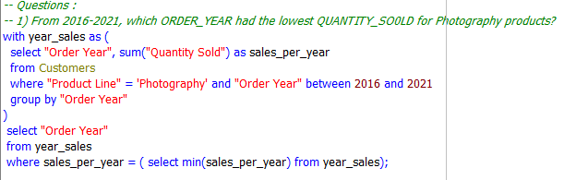
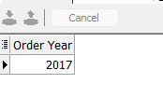
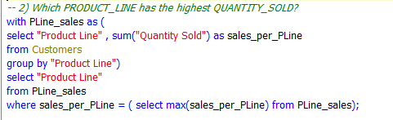


Slide 4
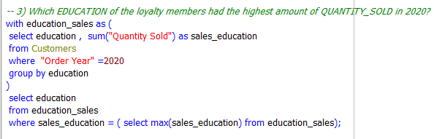




Slide 5
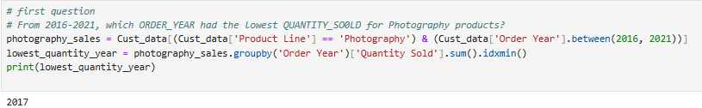
Project Steps
verifying the queries by using Python (Jupyter notebook).
After reading the file and converting it to a data frame and displaying a subset of the data

Slide 6
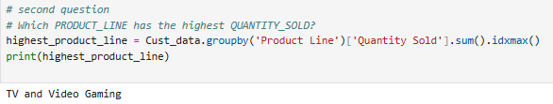
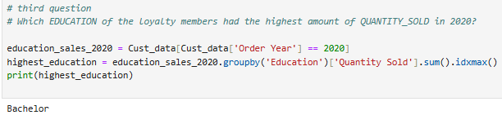
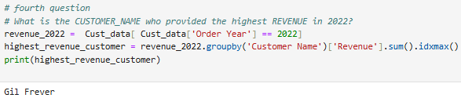

Slide 7
Project Steps
2. Getting insights from the data
Business Questions:
Percentage and values of Revenue vs Planned Revenue.
Percentage and values of Quantity Sold vs Target Sales.
Quantity Sold by Order Year and Quarter colored by Product Line
Forecast and predict the expected quantity sold (Range accepted) for all products in Q2 2023 with confidence level 95% based on historical data.

Slide 8
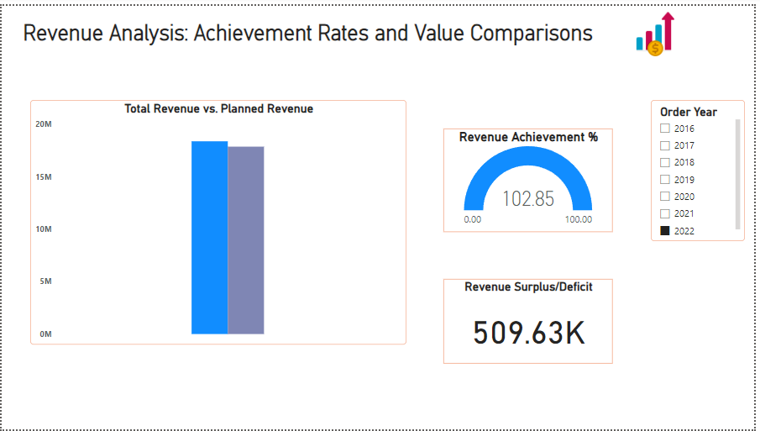
Report Features:
First Page:

Slide 9
Insights:
A comprehensive overview of revenue performance, comparing actual revenue to planned revenue across different years.
Key metrics :
total revenue VS planned revenue , revenue achievement percentage, and revenue surplus/deficit.
There are surpluses of revenues across the analyzed years (2022 Q1) indicating a great performance and growth in its business.
This could be because a successful marketing campaigns, increased sales team efforts, or favorable market conditions.
For example:
for 2022 there is a surplus of 509.63k which represent 2.85% higher than what was planned .

Slide 10
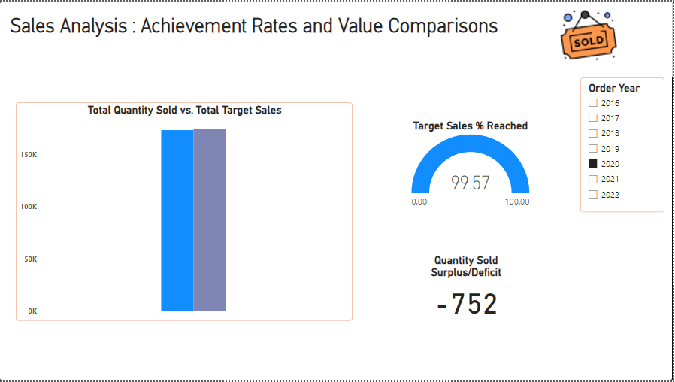
Report Features:
Second Page:

Slide 11
Insights:
An overview of a sales analysis that compares actual quantity sold against target sales for different order years.
Key metrics :
Total quantity sold VS Target sales, Target Sales % Reached, and Quantity Sold Surplus/Deficit.
Overall Sales Performance:
The total quantity sold for the analyzed period falls slightly short of the total target sales except for 2022.
This indicates a slight deficit in overall sales performance.
For example:
for 2020 there is a deficit of 752 than what was planned .

Slide 12
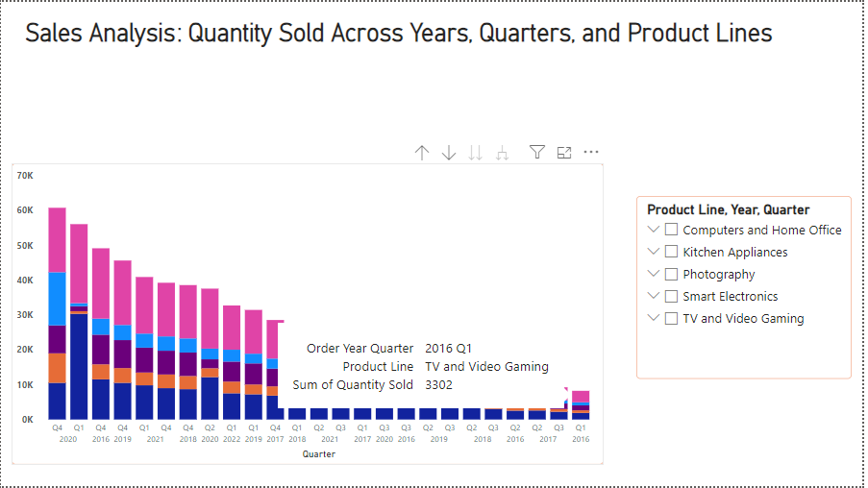
Report Features:
Third Page:

Slide 13
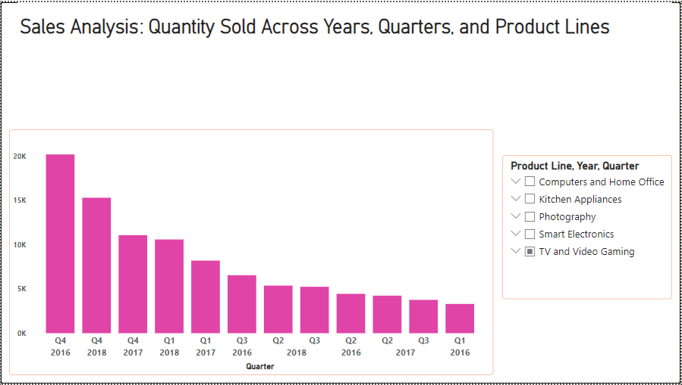
Insights:

Slide 14
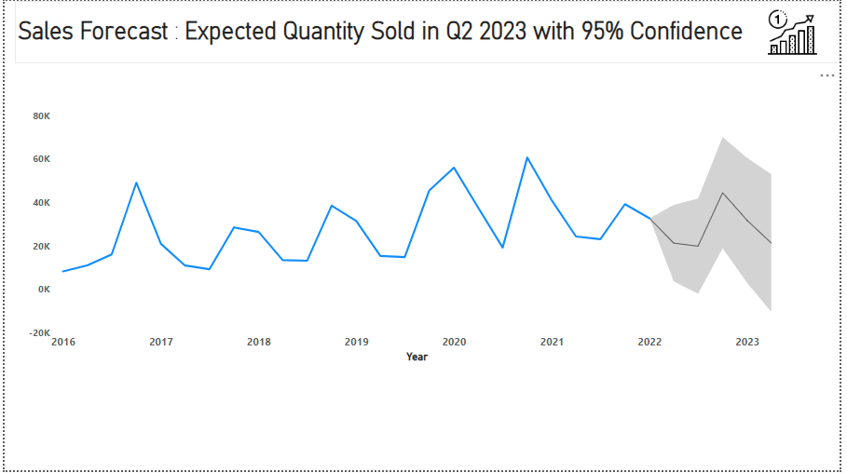
Report Features:
Fourth Page:

Slide 15
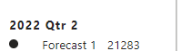




Insights:
Sales forecast for the expected quantity sold in Q2 2023 with a 95% confidence interval.
For 2022 Q2 : 2022 Q3: 2022 Q4: 2023 Q1 :
2023 Q2:

Slide 16
Thanks
Shorouk Abdelraouf

